Slide 1
CS162 Operating Systems and Systems Programming Lecture 19 Filesystems 1: Performance (Con’t), Queueing Theory, Filesystem Design
April 5th, 2022
Prof. Anthony Joseph and John Kubiatowicz
http://cs162.eecs.Berkeley.edu

Slide 2
Recall: Magnetic Disks
Track
Sector
Cylinders: all the tracks under the head at a given point on all surfaces
Read/write data is a three-stage process:
Seek time: position the head/arm over the proper track
Rotational latency: wait for desired sector to rotate under r/w head
Transfer time: transfer a block of bits (sector) under r/w head
Head
Cylinder
Platter
Disk Latency = Queueing Time + Controller time +
Seek Time + Rotation Time + Xfer Time
Software
Queue
(Device Driver)
Hardware
Controller
Media Time
(Seek+Rot+Xfer)
Request
Result

Slide 3
Recall: Typical Numbers for Magnetic Disk
Parameter | Info/Range
Space/Density | Space: 18TB (Seagate), 9 platters, in 3½ inch form factor! Areal Density: ≥ 1 Terabit/square inch! (PMR, Helium, …)
Average Seek Time | Typically 4-6 milliseconds
Average Rotational Latency | Most laptop/desktop disks rotate at 3600-7200 RPM (16-8 ms/rotation). Server disks up to 15,000 RPM. Average latency is halfway around disk so 4-8 milliseconds
Controller Time | Depends on controller hardware
Transfer Time | Typically 50 to 250 MB/s. Depends on: Transfer size (usually a sector): 512B – 1KB per sector Rotation speed: 3600 RPM to 15000 RPM Recording density: bits per inch on a track Diameter: ranges from 1 in to 5.25 in
Cost | Used to drop by a factor of two every 1.5 years (or faster), now slowing down

Slide 4
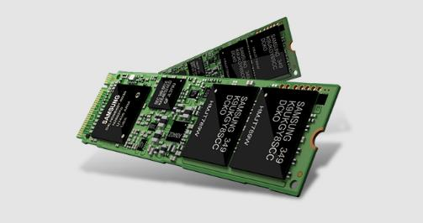
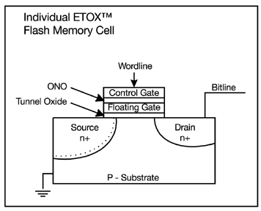
Recall: FLASH Memory
Samsung 2015:
512GB, NAND Flash
Like a normal transistor but:
Has a floating gate that can hold charge
To write: raise or lower wordline high enough to cause charges to tunnel
To read: turn on wordline as if normal transistor
presence of charge changes threshold and thus measured current
Two varieties:
NAND: denser, must be read and written in blocks
NOR: much less dense, fast to read and write
V-NAND: 3D stacking (Samsung claims 1TB possible in 1 chip)

Slide 5
Recall: SSD Summary
Pros (vs. hard disk drives):
Low latency, high throughput (eliminate seek/rotational delay)
No moving parts:
Very light weight, low power, silent, very shock insensitive
Read at memory speeds (limited by controller and I/O bus)
Cons
Small storage (0.1-0.5x disk), expensive (3-20x disk)
Hybrid alternative: combine small SSD with large HDD

Slide 6
Recall: SSD Summary
Pros (vs. hard disk drives):
Low latency, high throughput (eliminate seek/rotational delay)
No moving parts:
Very light weight, low power, silent, very shock insensitive
Read at memory speeds (limited by controller and I/O bus)
Cons
Small storage (0.1-0.5x disk), expensive (3-20x disk)
Hybrid alternative: combine small SSD with large HDD
Asymmetric block write performance: read pg/erase/write pg
Controller garbage collection (GC) algorithms have major effect on performance
Limited drive lifetime
1-10K writes/page for MLC NAND
Avg failure rate is 6 years, life expectancy is 9–11 years
These are changing rapidly!
No longer true!

Slide 7
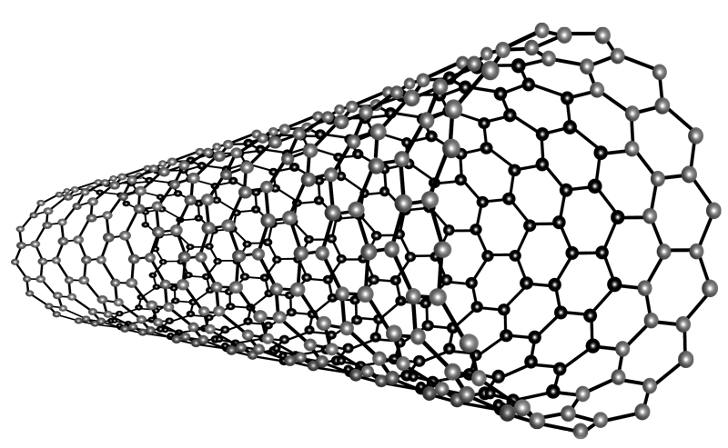
Nano-Tube Memory (NANTERO)
Yet another possibility: Nanotube memory
NanoTubes between two electrodes, slight conductivity difference between ones and zeros
No wearout!
Better than DRAM?
Speed of DRAM, no wearout, non-volatile!
Nantero promises 512Gb/dice for 8Tb/chip! (with 16 die stacking)

Slide 8
Ways of Measuring Performance: Times (s) and Rates (op/s)
Latency – time to complete a task
Measured in units of time (s, ms, us, …, hours, years)
Response Time - time to initiate and operation and get its response
Able to issue one that depends on the result
Know that it is done (anti-dependence, resource usage)
Throughput or Bandwidth – rate at which tasks are performed
Measured in units of things per unit time (ops/s, GFLOP/s)
Start up or “Overhead” – time to initiate an operation
Most I/O operations are roughly linear in b bytes
Latency(b) = Overhead + b/TransferCapacity
Performance???
Operation time (4 mins to run a mile…)
Rate (mph, mpg, …)

Slide 9
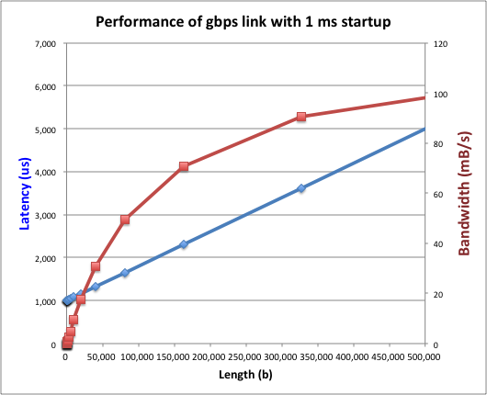
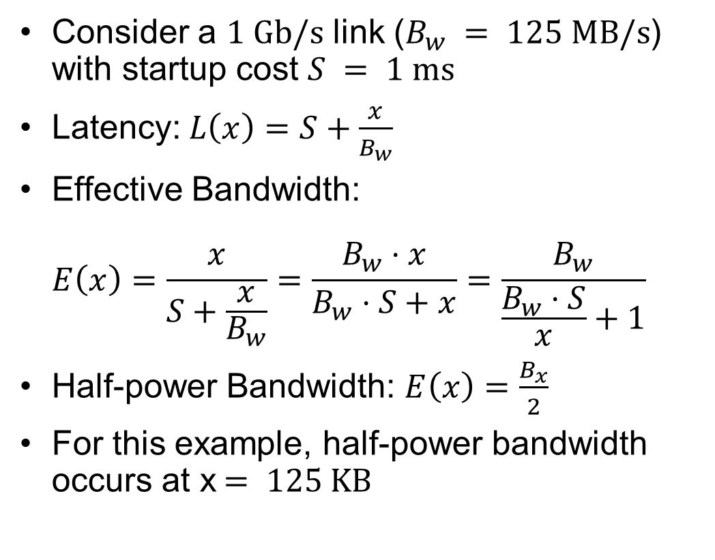
Example: Overhead in Fast Network
Consider a $1 \text{Gb}\text{/}\text{s}$ link ($B_{w} = 125 \text{MB}\text{/}\text{s}$) with startup cost $S = 1 \text{ms}$
Latency:$L\left(x\right)=S+\frac{x}{B_{w}}$
Effective Bandwidth: $E\left(x\right)=\frac{x}{S+\frac{x}{B_{w}}}=\frac{B_{w}⋅x}{B_{w}⋅S+x}=\frac{B_{w}}{\frac{B_{w}⋅S}{x}+1}$
Half-power Bandwidth: $E\left(x\right)=\frac{B_{x}}{2}$
For this example, half-power bandwidth occurs at x$= 125 \text{KB}$
Length (x)

Slide 10
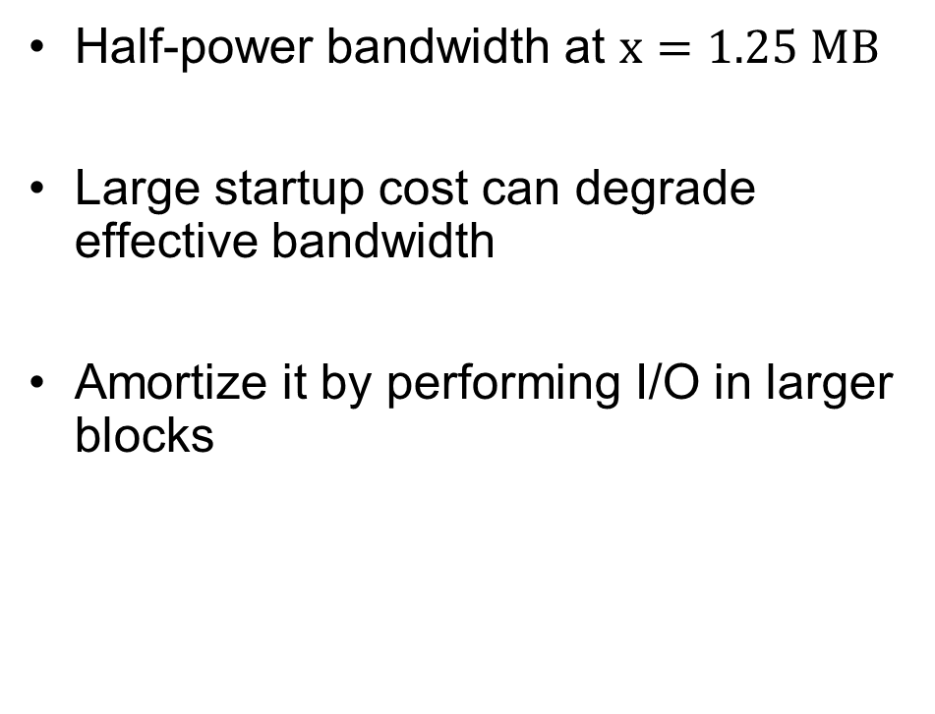
Example: 10 ms Startup Cost (e.g., Disk)
Half-power bandwidth at $x=1.25 \text{MB}$
Large startup cost can degrade effective bandwidth
Amortize it by performing I/O in larger blocks
Half-power x = 1,250,000 bytes!
Length (x)

Slide 11
What Determines Peak BW for I/O?
Bus Speed
PCI-X: 1064 MB/s = 133 MHz x 64 bit (per lane)
ULTRA WIDE SCSI: 40 MB/s
Serial Attached SCSI & Serial ATA & IEEE 1394 (firewire): 1.6 Gb/s full duplex (200 MB/s)
USB 3.0 – 5 Gb/s
Thunderbolt 3 – 40 Gb/s
Device Transfer Bandwidth
Rotational speed of disk
Write / Read rate of NAND flash
Signaling rate of network link
Whatever is the bottleneck in the path…

Slide 12
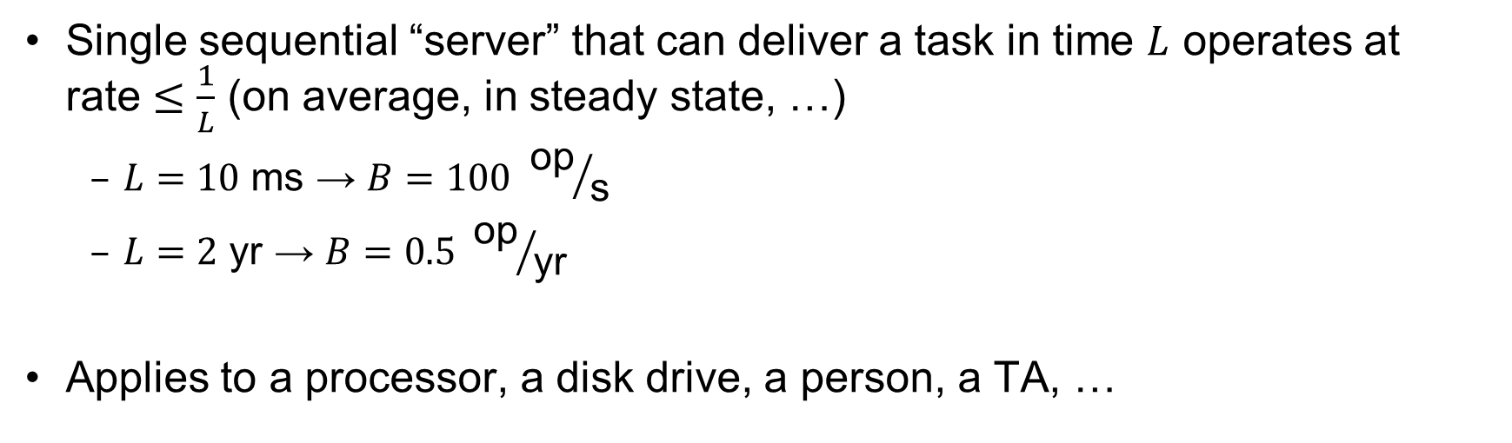
Sequential Server Performance
L
L
L
L
…
L
time
Single sequential “server” that can deliver a task in time $L$ operates at rate $≤\frac{1}{L}$ (on average, in steady state, …)
$L=10 \text{ms}$ → $B=100 {\text{op}}/{\text{s}}$
$L=2 \text{yr}$ → $B=0.5 {\text{op}}/{\text{yr}}$
Applies to a processor, a disk drive, a person, a TA, …

Slide 13
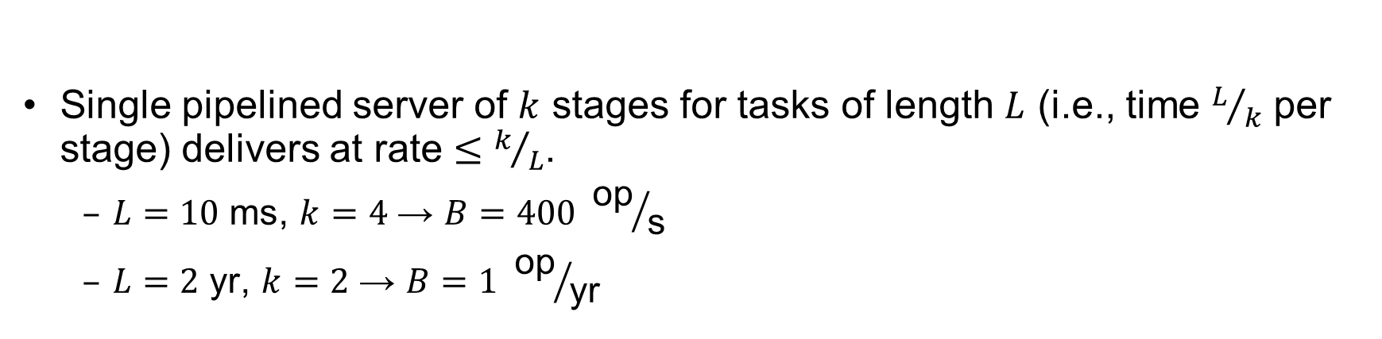
Single Pipelined Server
L
L
divided over distinct resources
logical operation
L
L
L
L
L
L
L
…
time
Single pipelined server of $k$ stages for tasks of length $L$ (i.e., time $L/k$ per stage) delivers at rate $≤k/L$.
$L=10 \text{ms}$, $k=4$ → $B=400 {\text{op}}/{\text{s}}$
$L=2 \text{yr}$, $k=2$ → $B=1 {\text{op}}/{\text{yr}}$

Slide 14
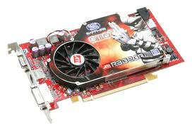
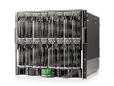
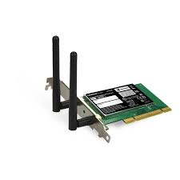
Example Systems “Pipelines”
I/O Processing
File
System
Upper Driver
Lower Driver
User Process
syscall
Communication
Anything with queues between operational process behaves roughly “pipeline like”
Important difference is that “initiations” are decoupled from processing
May have to queue up a burst of operations
Not synchronous and deterministic like in 61C

Slide 15
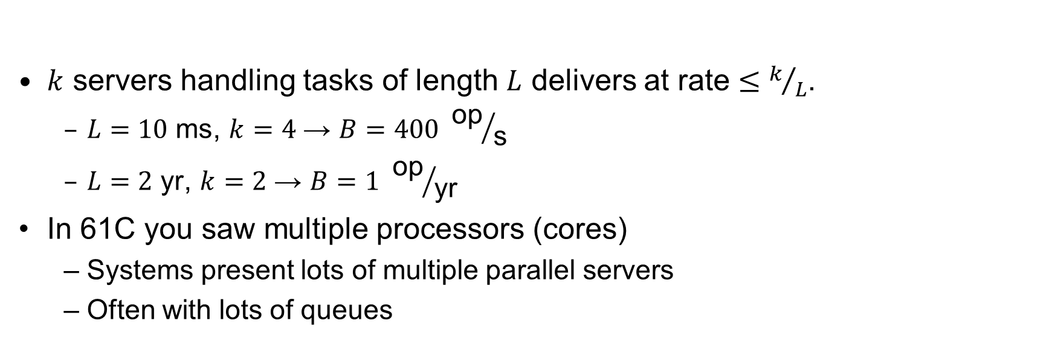
Multiple Servers
L
…
k
$k$ servers handling tasks of length $L$ delivers at rate $≤k/L$.
$L=10 \text{ms}$, $k=4$ → $B=400 {\text{op}}/{\text{s}}$
$L=2 \text{yr}$, $k=2$ → $B=1 {\text{op}}/{\text{yr}}$
In 61C you saw multiple processors (cores)
Systems present lots of multiple parallel servers
Often with lots of queues

Slide 16

Example Systems “Parallelism”
I/O Processing
syscall
File
System
Upper Driver
Lower Driver
User Process
User Process
User Process
Communication
Parallel Computation, Databases, …

Slide 17
I/O Performance
300
Response
Time (ms)
Controller
User
Thread
I/O
device
200
Queue
[OS Paths]
100
Response Time = Queue + I/O device service time
0
Performance of I/O subsystem
Metrics: Response Time, Throughput
Effective BW per op = transfer size / response time
EffBW(n) = n / (S + n/B) = B / (1 + SB/n )
0%
100%
Throughput (Utilization)
(% total BW)
# of ops
time per op
Fixed overhead

Slide 18
I/O Performance
300
Response
Time (ms)
Controller
User
Thread
I/O
device
200
Queue
[OS Paths]
100
Response Time = Queue + I/O device service time
0
Performance of I/O subsystem
Metrics: Response Time, Throughput
Effective BW per op = transfer size / response time
EffBW(n) = n / (S + n/B) = B / (1 + SB/n )
Contributing factors to latency:
Software paths (can be loosely modeled by a queue)
Hardware controller
I/O device service time
Queuing behavior:
Can lead to big increases of latency as utilization increases
Solutions?
0%
100%
Throughput (Utilization)
(% total BW)

Slide 19
A Simple Deterministic World
arrivals
Queue
Server
departures
T_{Q}
T_{S}
T_{A}
T_{A}
T_{A}
T_{q}
T_{S}
Assume requests arrive at regular intervals, take a fixed time to process, with plenty of time between …
Service rate (μ = 1/T_{S}) - operations per second
Arrival rate: (λ = 1/T_{A}) - requests per second
Utilization: U = λ/μ , where λ < μ
Average rate is the complete story

Slide 20
A Ideal Linear World
Saturation
1
1
Delivered Throughput
Delivered Throughput
Empty Queue
Unbounded
0
1
0
1
Offered Load (T_{S}/T_{A})
Offered Load (T_{S}/T_{A})
Queue delay
Queue delay
time
time
What does the queue wait time look like?
Grows unbounded at a rate ~ (T_{s}/T_{A}) till request rate subsides

Slide 21
A Bursty World
arrivals
Queue
Server
departures
T_{Q}
T_{S}
Arrivals
Q depth
Server
Requests arrive in a burst, must queue up till served
Same average arrival time, but almost all of the requests experience large queue delays
Even though average utilization is low

Slide 22
So how do we model the burstiness of arrival?
Elegant mathematical framework if you start with exponential distribution
Probability density function of a continuous random variable with a mean of 1/λ
f(x) = λe^{-λx}
“Memoryless”
Likelihood of an event occurring is independent of how long we’ve been waiting
mean arrival interval (1/λ)
Lots of short arrival intervals (i.e., high instantaneous rate)
Few long gaps (i.e., low instantaneous rate)
x (λ)

Slide 23
Background: General Use of Random Distributions
Mean
(m)
Server spends variable time (T) with customers
Mean (Average) m = Σp(T)×T
Variance (stddev²) σ² = Σp(T)×(T-m)² = Σp(T)×T²-m²
Squared coefficient of variance: C = σ²/m² Aggregate description of the distribution
Important values of C:
No variance or deterministic ⇒ C=0
“Memoryless” or exponential ⇒ C=1
Past tells nothing about future
Poisson process – purely or completely random process
Many complex systems (or aggregates) are well described as memoryless
Disk response times C ≈ 1.5 (majority seeks < average)
σ
Distribution
of service times
mean
Memoryless

Slide 24
Introduction to Queuing Theory
Controller
Arrivals
Disk
Departures
Queue
Queuing System
What about queuing time??
Let’s apply some queuing theory
Queuing Theory applies to long term, steady state behavior ⇒ Arrival rate = Departure rate
Arrivals characterized by some probabilistic distribution
Departures characterized by some probabilistic distribution
Notes:
Old and New Testament by Kleirock
Regret skipping as grad student

Slide 25
Little’s Law
N
arrivals
departures
λ
L
In any stable system
Average arrival rate = Average departure rate
The average number of jobs/tasks in the system (N) is equal to arrival time / throughput (λ) times the response time (L)
N (jobs) = λ (jobs/s) x L (s)
Regardless of structure, bursts of requests, variation in service
Instantaneous variations, but it washes out in the average
Overall, requests match departures

Slide 26
Example
L = 5
λ = 1
L = 5
N = 5 jobs
Jobs
0
1
2
3
4
5
6
7
8
9
10
11
12
13
14
15
16
time
A: N = λ x L
E.g., N = λ x L = 5

Slide 27
Little’s Theorem: Proof Sketch
N
arrivals
departures
λ
Job i
L(i) = response time of job i
N(t) = number of jobs in system
at time t
L
N(t)
time
L(1)
T

Slide 28
Little’s Theorem: Proof Sketch
N
arrivals
departures
λ
Job i
L(i) = response time of job i
N(t) = number of jobs in system
at time t
L
N(t)
time
T
What is the system occupancy, i.e., average
number of jobs in the system?

Slide 29
Little’s Theorem: Proof Sketch
N
arrivals
departures
λ
Job i
L(i) = response time of job i
N(t) = number of jobs in system
at time t
S(i) = L(i) * 1 = L(i)
L
S(k)
N(t)
S(2)
S(1)
time
T
S = S(1) + S(2) + … + S(k) = L(1) + L(2) + … + L(k)

Slide 30
Little’s Theorem: Proof Sketch
N
arrivals
departures
λ
Job i
L(i) = response time of job i
N(t) = number of jobs in system
at time t
S(i) = L(i) * 1 = L(i)
L
N(t)
S= area
time
T
Average occupancy (N_{avg}) = S/T

Slide 31
Little’s Theorem: Proof Sketch
N
arrivals
departures
λ
Job i
L(i) = response time of job i
N(t) = number of jobs in system
at time t
S(i) = L(i) * 1 = L(i)
L
S(k)
N(t)
S(2)
S(1)
time
T
N_{avg} = S/T = (L(1) + … + L(k))/T

Slide 32
Little’s Theorem: Proof Sketch
N
arrivals
departures
λ
Job i
L(i) = response time of job i
N(t) = number of jobs in system
at time t
S(i) = L(i) * 1 = L(i)
L
S(k)
N(t)
S(2)
S(1)
time
T
N_{avg} = (L(1) + … + L(k))/T = (N_{total}/T)*(L(1) + … + L(k))/N_{total}

Slide 33
Little’s Theorem: Proof Sketch
N
arrivals
departures
λ
Job i
L(i) = response time of job i
N(t) = number of jobs in system
at time t
S(i) = L(i) * 1 = L(i)
L
S(k)
N(t)
S(2)
S(1)
time
T
N_{avg} = (N_{total}/T)*(L(1) + … + L(k))/N_{total} = λ_{avg} × L_{avg}

Slide 34
Little’s Theorem: Proof Sketch
N
arrivals
departures
λ
Job i
L(i) = response time of job i
N(t) = number of jobs in system
at time t
S(i) = L(i) * 1 = L(i)
L
S(k)
N(t)
S(2)
S(1)
time
T
N_{avg} = λ_{avg} × L_{avg}

Slide 35

Little’s Law Applied to a Queue
When Little’s Law applied to a queue, we get:
Average Arrival Rate
$$L_{Q}=λT_{Q}$$
Average length of the queue
Average time “waiting” in queue

Slide 36
A Little Queuing Theory: Computing T_{Q}
Assumptions:
System in equilibrium; No limit to the queue
Time between successive arrivals is random and memoryless
Parameters that describe our system:
λ: mean number of arriving customers/second
T_{ser}: mean time to service a customer (“m1”)
C: squared coefficient of variance = σ²/m1²
μ: service rate = 1/T_{ser}
u: server utilization (0≤u≤1): u = λ/μ = λ × T_{ser}
Results:
Memoryless service distribution (C = 1): (an “M/M/1 queue”):
T_{q} = T_{ser} x u/(1 – u)
General service distribution, 1 server (an “M/G/1 queue”):
T_{q} = T_{ser} x ½(1+C) x u/(1 – u)
Why does response/queueing delay grow unboundedly even though the utilization is < 1 ?
Queue
Server
300
Response
Time (ms)
Arrival Rate
λ
Service Rate
μ=1/T_{ser}
200
100
0
0%
100%
Throughput (Utilization)
(% total BW)

Slide 37
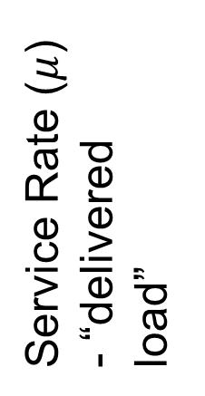
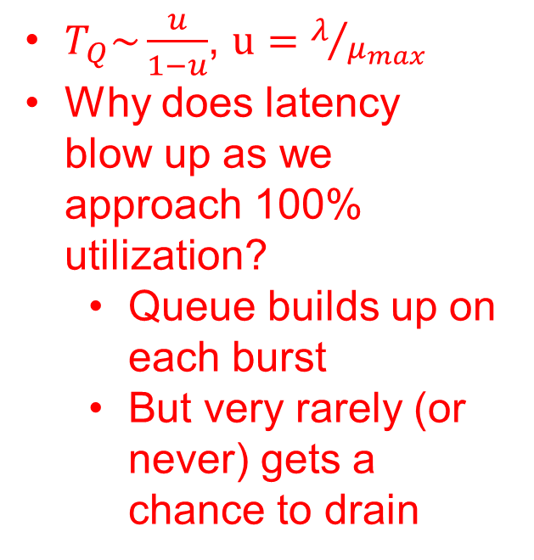
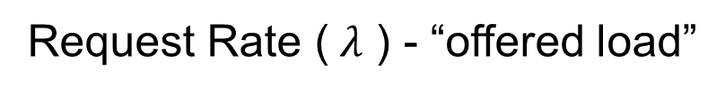
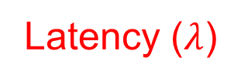
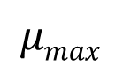
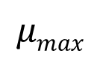
System Performance In presence of a Queue
$T_{Q}\sim \frac{u}{1−u}$, $u=λ/{μ_{max}}$
Why does latency blow up as we approach 100% utilization?
Queue builds up on each burst
But very rarely (or never) gets a chance to drain
Latency ($λ$)
Service Rate ($μ$) - “delivered load”
Time
$$μmax$$
Operation Time
$$μmax$$
Request Rate ($λ$ ) - “offered load”
“Half-Power Point” : load at which system delivers half of peak performance
Design and provision systems to operate roughly in this regime
Latency low and predictable, utilization good: ~50%

Slide 38
Why unbounded response time?
Assume deterministic arrival process and service time
Possible to sustain utilization = 1 with bounded response time!
time
arrival time
service time

Slide 39
Why unbounded response time?
300
Response
Time (ms)
Assume stochastic arrival process (and service time)
No longer possible to achieve utilization = 1
200
100
This wasted time can never be reclaimed! So cannot achieve u = 1!
0
0%
100%
Throughput (Utilization)
(% total BW)
time

Slide 40
A Little Queuing Theory: An Example
Example Usage Statistics:
User requests 10 x 8KB disk I/Os per second
Requests & service exponentially distributed (C=1.0)
Avg. service = 20 ms (From controller+seek+rot+trans)
Questions:
How utilized is the disk?
Ans: server utilization, u = λT_{ser}
What is the average time spent in the queue?
Ans: T_{q}
What is the number of requests in the queue?
Ans: L_{q}
What is the avg response time for disk request?
Ans: T_{sys} = T_{q} + T_{ser}
Computation:
λ (avg # arriving customers/s) = 10/s
T_{ser} (avg time to service customer) = 20 ms (0.02s)
u (server utilization) = λ x T_{ser}= 10/s x .02s = 0.2
T_{q} (avg time/customer in queue) = T_{ser} x u/(1 – u) = 20 x 0.2/(1-0.2) = 20 x 0.25 = 5 ms (0 .005s)
L_{q} (avg length of queue) = λ x T_{q}=10/s x .005s = 0.05
T_{sys} (avg time/customer in system) =T_{q} + T_{ser}= 25 ms

Slide 41
Queuing Theory Resources
Resources page contains Queueing Theory Resources (under Readings):
Scanned pages from Patterson and Hennessy book that gives further discussion and simple proof for general equation: https://cs162.eecs.berkeley.edu/static/readings/patterson_queue.pdf
A complete website full of resources: http://web2.uwindsor.ca/math/hlynka/qonline.html
Some previous midterms with queueing theory questions
Assume that Queueing Theory is fair game for Midterm III!

Slide 42
Optimize I/O Performance
Controller
300
Response
Time (ms)
User
Thread
I/O
device
200
Queue
[OS Paths]
100
Response Time = Queue + I/O device service time
0
0%
100%
How to improve performance?
Make everything faster ☺
More Decoupled (Parallelism) systems
multiple independent buses or controllers
Optimize the bottleneck to increase service rate
Use the queue to optimize the service
Do other useful work while waiting
Queues absorb bursts and smooth the flow
Admissions control (finite queues)
Limits delays, but may introduce unfairness and livelock
Throughput (Utilization)
(% total BW)

Slide 43
When is Disk Performance Highest?
When there are big sequential reads, or
When there is so much work to do that they can be piggy backed (reordering queues—one moment)
OK to be inefficient when things are mostly idle
Bursts are both a threat and an opportunity
<your idea for optimization goes here>
Waste space for speed?
Other techniques:
Reduce overhead through user level drivers
Reduce the impact of I/O delays by doing other useful work in the meantime

Slide 44
Disk Scheduling (1/3)
Disk can do only one request at a time; What order do you choose to do queued requests?
FIFO Order
Fair among requesters, but order of arrival may be to random spots on the disk ⇒ Very long seeks
SSTF: Shortest seek time first
Pick the request that’s closest on the disk
Although called SSTF, today must include rotational delay in calculation, since rotation can be as long as seek
Con: SSTF good at reducing seeks, but may lead to starvation
User
Requests
2,2
5,2
7,2
3,10
2,1
2,3
Head
3
Disk Head
2
1
4

Slide 45
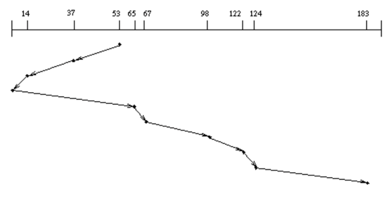
Disk Scheduling (2/3)
Disk can do only one request at a time; What order do you choose to do queued requests?
SCAN: Implements an Elevator Algorithm: take the closest request in the direction of travel
No starvation, but retains flavor of SSTF
User
Requests
2,2
5,2
7,2
3,10
2,1
2,3
Head

Slide 46
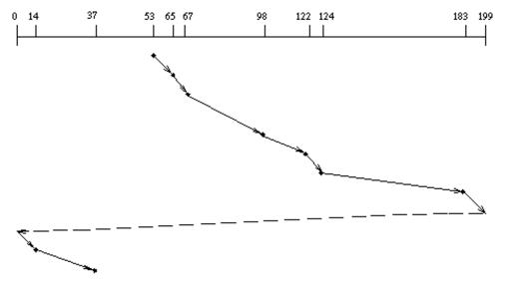
Disk Scheduling (3/3)
Disk can do only one request at a time; What order do you choose to do queued requests?
C-SCAN: Circular-Scan: only goes in one direction
Skips any requests on the way back
Fairer than SCAN, not biased towards pages in middle
User
Requests
2,2
5,2
7,2
3,10
2,1
2,3
Head

Slide 47
Recall: How do we Hide I/O Latency?
Blocking Interface: “Wait”
When request data (e.g., read() system call), put process to sleep until data is ready
When write data (e.g., write() system call), put process to sleep until device is ready for data
Non-blocking Interface: “Don’t Wait”
Returns quickly from read or write request with count of bytes successfully transferred to kernel
Read may return nothing, write may write nothing
Asynchronous Interface: “Tell Me Later”
When requesting data, take pointer to user’s buffer, return immediately; later kernel fills buffer and notifies user
When sending data, take pointer to user’s buffer, return immediately; later kernel takes data and notifies user

Slide 48

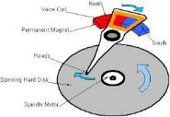




Recall: I/O and Storage Layers
Application / Service
High Level I/O
Streams
Low Level I/O
File Descriptors
What we covered in Lecture 4
Syscall
open(), read(), write(), close(), …
Open File Descriptions
File System
Files/Directories/Indexes
What we will cover next…
I/O Driver
Commands and Data Transfers
Disks, Flash, Controllers, DMA
What we just covered…

Slide 49
From Storage to File Systems
I/O API and
syscalls
Variable-Size Buffer
Memory Address
Logical Index, Typically 4 KB
File System
Block
Flash Trans. Layer
Hardware Devices
Sector(s)
Sector(s)
Sector(s)
Phys. Block
Phys Index., 4KB
Physical Index,
512B or 4KB
Erasure Page
HDD
SSD

Slide 50
Building a File System
File System: Layer of OS that transforms block interface of disks (or other block devices) into Files, Directories, etc.
Classic OS situation: Take limited hardware interface (array of blocks) and provide a more convenient/useful interface with:
Naming: Find file by name, not block numbers
Organize file names with directories
Organization: Map files to blocks
Protection: Enforce access restrictions
Reliability: Keep files intact despite crashes, hardware failures, etc.

Slide 51
Recall: User vs. System View of a File
User’s view:
Durable Data Structures
System’s view (system call interface):
Collection of Bytes (UNIX)
Doesn’t matter to system what kind of data structures you want to store on disk!
System’s view (inside OS):
Collection of blocks (a block is a logical transfer unit, while a sector is the physical transfer unit)
Block size ≥ sector size; in UNIX, block size is 4KB

Slide 52

Translation from User to System View
File (Bytes)
File
System
What happens if user says: “give me bytes 2 – 12?”
Fetch block corresponding to those bytes
Return just the correct portion of the block
What about writing bytes 2 – 12?
Fetch block, modify relevant portion, write out block
Everything inside file system is in terms of whole-size blocks
Actual disk I/O happens in blocks
read/write smaller than block size needs to translate and buffer

Slide 53
Disk Management
Basic entities on a disk:
File: user-visible group of blocks arranged sequentially in logical space
Directory: user-visible index mapping names to files
The disk is accessed as linear array of sectors
How to identify a sector?
Physical position
Sectors is a vector [cylinder, surface, sector]
Not used anymore
OS/BIOS must deal with bad sectors
Logical Block Addressing (LBA)
Every sector has integer address
Controller translates from address ⇒ physical position
Shields OS from structure of disk

Slide 54
What Does the File System Need?
Track free disk blocks
Need to know where to put newly written data
Track which blocks contain data for which files
Need to know where to read a file from
Track files in a directory
Find list of file's blocks given its name
Where do we maintain all of this?
Somewhere on disk

Slide 55
Conclusion
Disk Performance:
Queuing time + Controller + Seek + Rotational + Transfer
Rotational latency: on average ½ rotation
Transfer time: spec of disk depends on rotation speed and bit storage density
Devices have complex interaction and performance characteristics
Response time (Latency) = Queue + Overhead + Transfer
Effective BW = BW * T/(S+T)
HDD: Queuing time + controller + seek + rotation + transfer
SDD: Queuing time + controller + transfer (erasure & wear)
Systems (e.g., file system) designed to optimize performance and reliability
Relative to performance characteristics of underlying device
Bursts & High Utilization introduce queuing delays
Queuing Latency:
M/M/1 and M/G/1 queues: simplest to analyze
As utilization approaches 100%, latency → ∞
T_{q} = T_{ser} x ½(1+C) x u/(1 – u))

